Slide 1

Reinforcement Learning
Digital Organizations SE - Assignement
by Damiano Rousselet - 12225451
Notes:
We have collected an array of questions on every topic. However, we have chosen a smaller selection of questions to be discussed given the short timeframe of the discussion. These questions are marked in bold.

Slide 2

BASICS
BASICS
DETAILS
EXAMPLE
Idea comes from natural experiences: learn from the environment by interacting with it.
Get rewards or losses (punishments)
computational approach to learning from actions
Formal definition: Reinforcement learning is a framework for solving control tasks (also called decision problems) by building agents that learn from the environment by interacting with it through trial and error and receiving rewards (positive or negative) as unique feedback.
Based on Reward hypothesis: all goals can be described as the maximization of the expected return (expected cumulative reward).
Learn to take actions that maximize the expected cumulative reward.
RL process also called “Markov Decision Process”

Slide 3
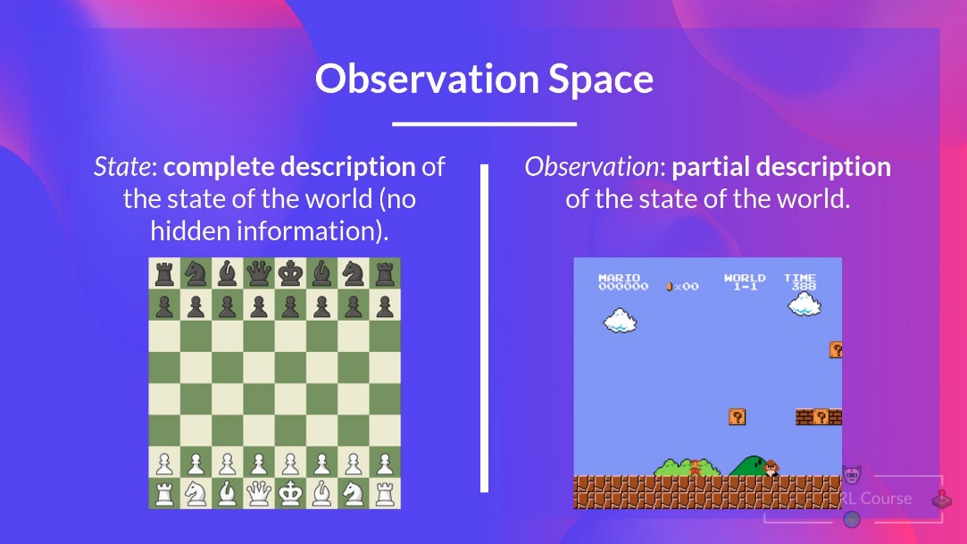
BASICS
DETAILS
EXAMPLE
STATE & OBSERVATION
“Markov Property implies that our agent needs only the current state to decide what action to take and not the history of all the states and actions they took before.”
State → Complete description of the state of the world (no hidden information). Fully observed environment
E.g.: In chess → Full information from the environment (we see entire chess board) = state
Observation: Partial description of the state. Partially observed environment.
E.g.: In video game: See only part where u are playing

Slide 4

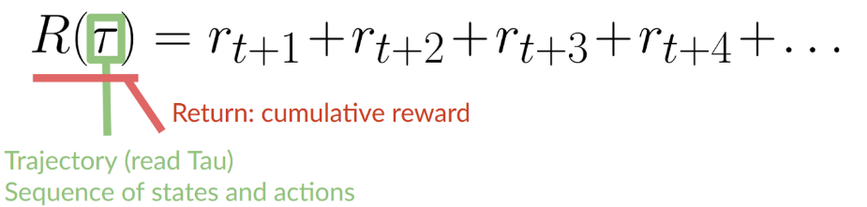
BASICS
DETAILS
EXAMPLE
ACTION SPACE & CUMULATIVE REWARD
Action space: Set of all possible actions in an environment.
Discrete: Finite set of possible actions (Chess)
Continuous: Infinite set of possible actions (self-driving car)
Reward is the only feedback agent gets.
Cumulative reward = sum of all rewards in the sequence.
Written as:
BUT! Rewards that come sooner are more likely to happen.
Far future rewards are less likely → Discounted…..

Slide 5
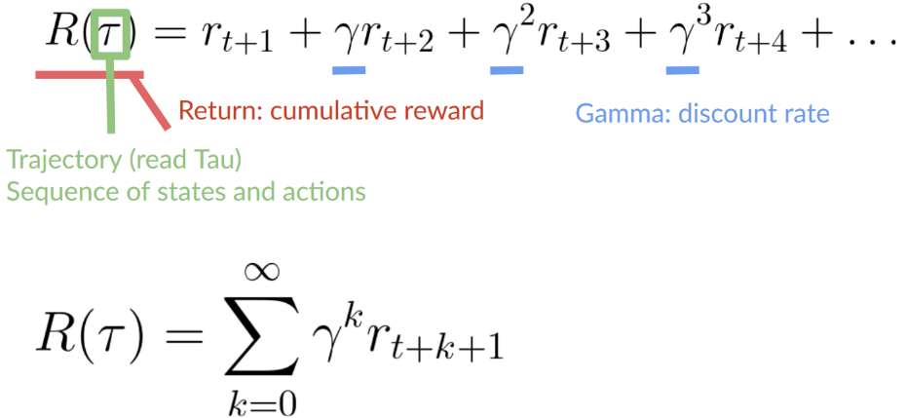
BASICS
DETAILS
EXAMPLE
REWARD DISCOUNTING
Reward discounted with gamma: γ → Defined {0,1}
Larger γ → less discount → Care more about future
Smaller γ → more discount → Care less about future
Future rewards will be discounted by gamma to the exponent of the time step.
Higher exponent → smaller gamma → more discount for future steps (less reward for far future)

Slide 6
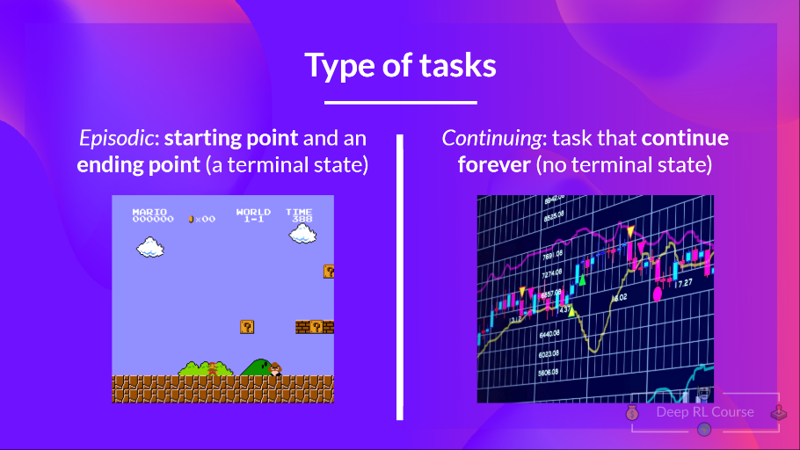
BASICS
DETAILS
EXAMPLE
TYPE OF TASK
Task → Instance of RL problem. 2 Types:
Episodic: Starting & ending point (terminal state).
E.g. Video game: task starts at new Level, ends when killed or reached the end of the level.
Continuing: Task continues forever (no terminal state)

Slide 7
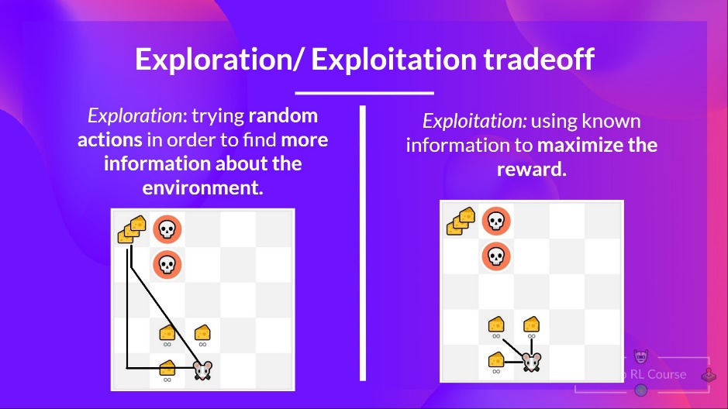
BASICS
DETAILS
EXAMPLE
EXPLORATION / EXPLOITATION TRADE-OFF
Exploration / exploitation trade-off → Need rule to choose:

Slide 8
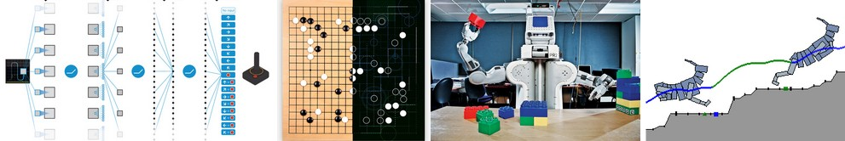
BASICS
DETAILS
EXAMPLE
POLICY π
The Policy π: Function that tells what action to take given the current state (brain of agent)
Goal: find optimal policy π* → maximizes expected return when agent acts according to it
Find π* → Training:
Directly: Teaching agent which action take, given current state: Policy-based methods
Indirectly: Teaching agent which state is more valuable → Action to reach more valuable states: Value-based methods

Slide 9
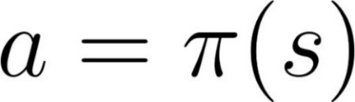
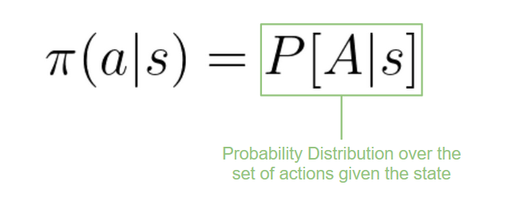
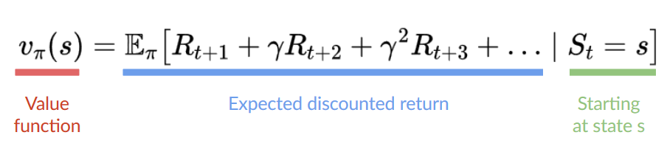
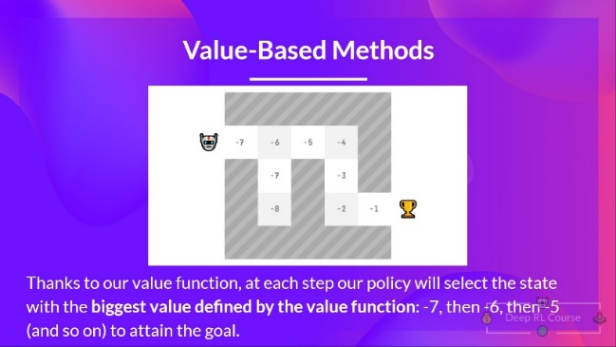
BASICS
DETAILS
EXAMPLE
POLICY VS VALUE METHODS
Policy-based methods: Define mapping from each state → Best action / probability distribution over the set of possible actions.
Deterministic: Given state s → always return the same action a
Stochastic: probability distribution over actions:
Value-based methods: Learn a value function → Maps state to expected value of being in that state.
Value of state: Expected discounted return agent can get if it starts in that s and acts according to policy.
“According to policy” → Policy going to state with higher value.

Slide 10
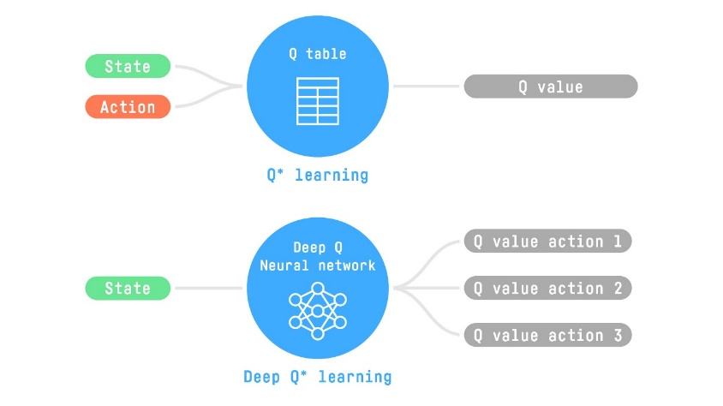
BASICS
DETAILS
EXAMPLE
„DEEP“ REINFORCEMENT LEARNING
Introduce neural networks for RL problems
E.g. Q-learning vs. deep Q-learning:

Slide 11
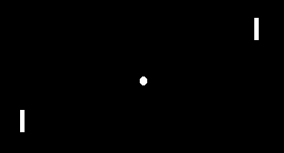
BASICS
DETAILS
EXAMPLE
PONG FROM PIXELS
From famous researcher Andrej Karpathy
Pong: Atari 2600 game; example for reinforcement learning
Game environment: rectangular field, two paddles, one ball
Agent objective: control paddle, play effectively
Pixel inputs: raw observations of game screen
Actions: discrete, move the paddle up, down, or nothing
Rewards: positive or negative, based on game outcome and moves
Deep neural network: CNN for pixel processing and action prediction
Experience replay: store and sample past experiences for training
DQN algorithm: train agent by approximating Q-function for future rewards
Application: show deep reinforcement learning potential for complex games from visual inputs
Example CoLab from GitHub user (Click Runtime => Run all )

Slide 12
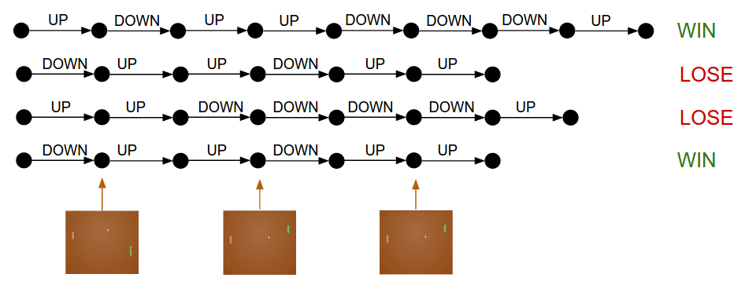
BASICS
DETAILS
EXAMPLE
PONG FROM PIXELS
Training protocol:
Initialize policy network with W1, W2
Play 100 Pong games (policy rollouts)
Label each decision (UP or DOWN) as good or bad based on game outcome
Update network parameters to encourage good decisions and discourage bad ones
Repeat with a new policy
Cartoon diagram of 4 games. Each black circle is some game state (three example states are visualized on the bottom), and each arrow is a transition, annotated with the action that was sampled. In this case, we won 2 games and lost 2 games. With Policy Gradients we would take the two games we won and slightly encourage every single action we made in that episode. Conversely, we would also take the two games we lost and slightly discourage every single action we made in that episode.

Slide 13
BASICS
DETAILS
EXAMPLE
PONG FROM PIXELS
Learning:
Learning policy gradients for Pong with a 2-layer neural network
Used OpenAI Gym's ATARI 2600 Pong environment and Python script
Trained on batches of 10 episodes with RMSProp optimizer
Achieved a policy that is slightly better than the AI player after 3 nights
Played about 200,000 games and made ~800 updates
Could improve performance with ConvNets, GPU and hyperparameter tuning

Slide 14
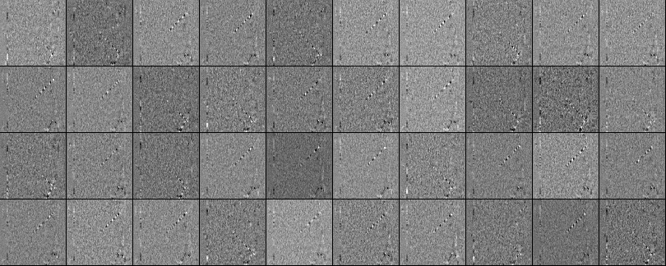
BASICS
DETAILS
EXAMPLE
PONG FROM PIXELS
Learned weights:
Way to visualize the neurons in W1
Each row of W1 is an 80x80 difference image (current - last frame)
40 neurons (out of 200) shown in a grid with white/black pixels for positive/negative weights
Some neurons detect traces of bouncing ball along a line with black/white alternation
Neuron activity fluctuates as a sine wave and fires at discrete positions due to ReLU
Images have some noise, possibly reduced by L2 regularization

Slide 15
BASICS
DETAILS
EXAMPLE
THANK YOU!

Slide 16
BASICS
DETAILS
EXAMPLE
References:
- Deep Reinforcement Learning: Pong from Pixels (karpathy.github.io)
- https://gist.github.com/karpathy/a4166c7fe253700972fcbc77e4ea32c5
- https://colab.research.google.com/drive/1w1EklesVqWaCOK2KyidJbauarn7kUoaV#scrollTo=G6Ka_5Vl9Orm

